Slide 1
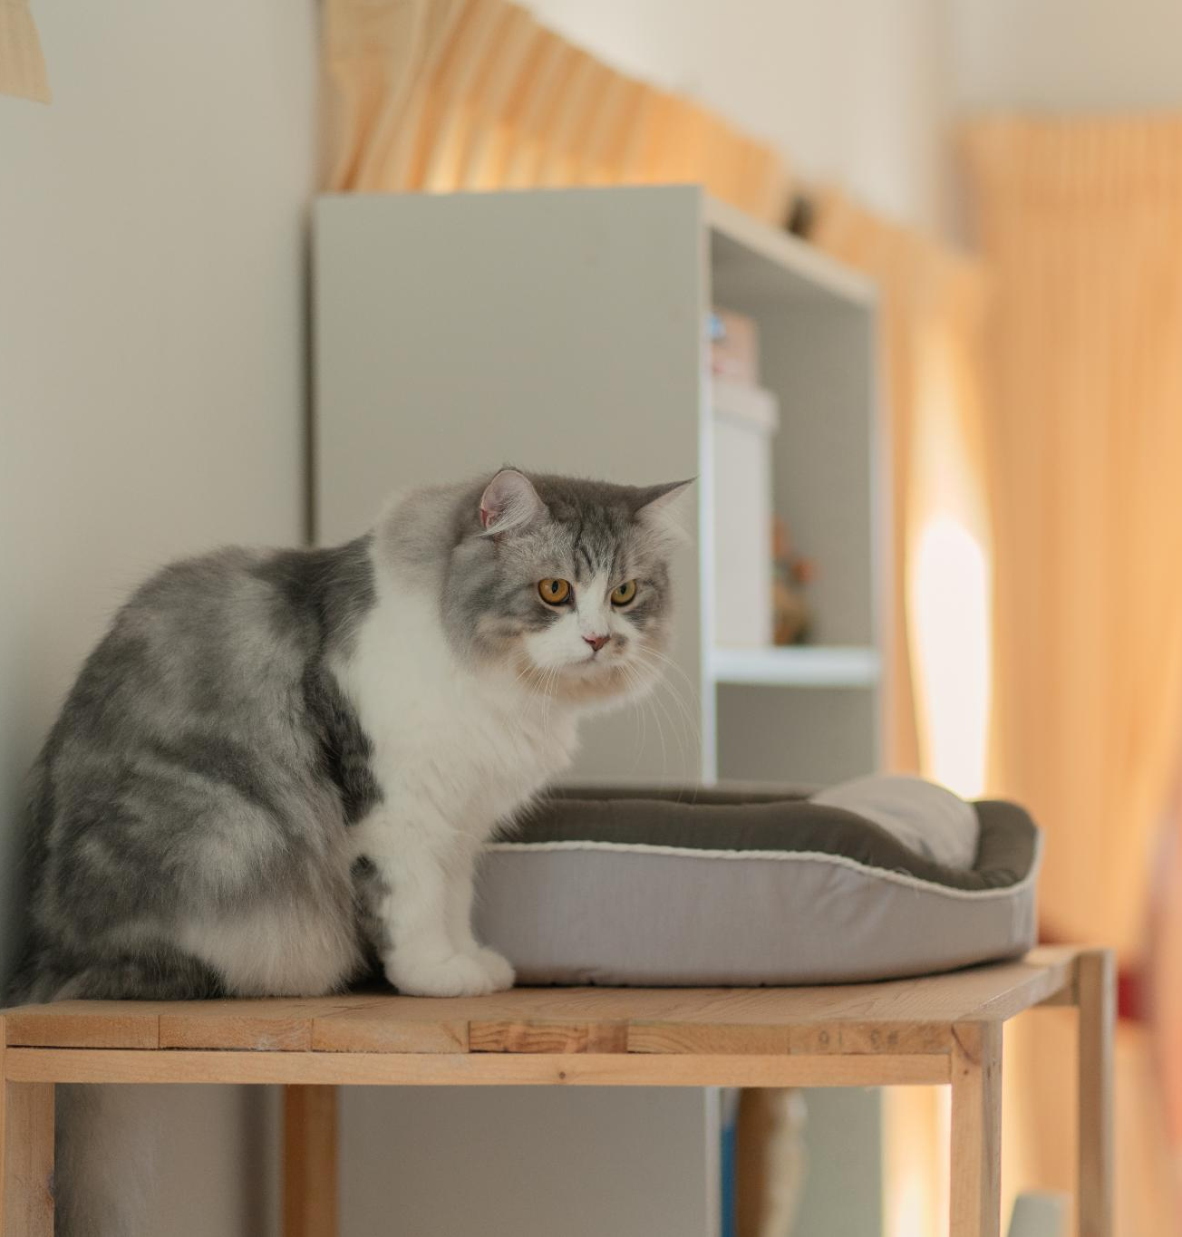
Innovative Cat Bed Design with Integrated Heating Pad
Revolutionary comfort for cats and their owners.
Notes:
AI-generated content may be incorrect. --- This presentation showcases an innovative cat bed design that includes an integrated heating pad, focusing on how it meets the needs of both cats and their owners. We will explore the features, benefits, market potential, and visual representations of this product.

Slide 2
Overview of the Design Concept
Cozy Cat Environment
The design focuses on creating a warm and inviting space that enhances the comfort of cats, making them feel secure.
Efficient Heating Pad
An innovative heating pad is integrated into the design, providing gentle warmth that caters to cats' needs during colder months.
Addressing Comfort Concerns
This design concept addresses pet owners' concerns about their cats' comfort, ensuring a warm and cozy environment.
Notes:
The design concept revolves around creating a cozy and warm environment for cats, integrating an efficient heating pad that provides gentle warmth, especially during colder months. This addresses a common concern among pet owners regarding their cats' comfort.

Slide 3
Integrated Heating Pad
Adjustable Temperature Control
The integrated heating pad allows for adjustable temperature settings, ensuring optimal comfort for your cat.
Promotes Relaxation
The warmth from the heating pad promotes relaxation, helping to reduce stress and anxiety in cats.
Ideal for Cold Weather
The heating pad feature is especially beneficial during cold weather, providing a cozy and warm environment for pets.
Notes:
The cat bed includes a built-in heating pad that can be adjusted for temperature. This feature ensures that cats remain warm and comfortable, promoting relaxation and well-being, especially during cold weather.

Slide 4
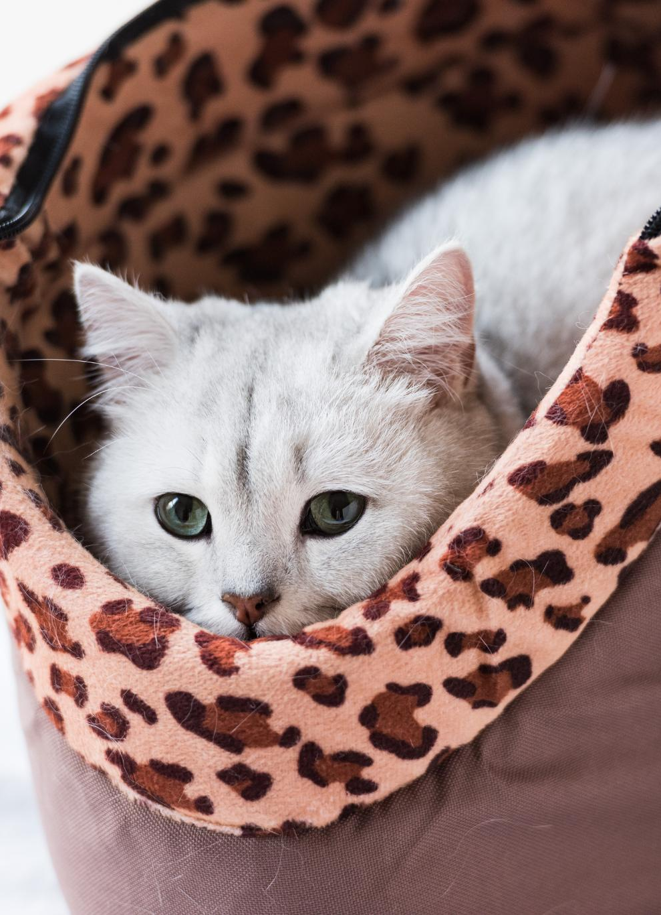
Comfortable and Durable Materials
High-Quality Materials
The cat bed is constructed from high-quality materials that ensure durability and comfort for daily use.
Comfort for Cats
The soft fabric of the cat bed encourages cats to curl up and relax, providing them with a cozy resting place.
Longevity of Use
Designed to withstand daily use, the materials ensure that the cat bed remains in good condition over time.
Notes:
Constructed from high-quality, durable materials, the cat bed provides comfort and longevity. The soft fabric encourages cats to curl up while ensuring that the bed withstands daily use.

Slide 5
Health Benefits for Cats
Alleviating Joint Pain
Heating pads can alleviate joint pain and stiffness, making them particularly beneficial for senior cats.
Enhanced Comfort
The warmth from a heating pad helps improve overall comfort for cats, leading to a happier pet.
Promoting Well-being
By providing warmth, heating pads can promote the overall well-being of cats, especially those with mobility issues.
Notes:
The warmth provided by the heating pad can aid in alleviating discomfort from joint pain and stiffness, particularly for senior cats. Improved comfort can lead to healthier, happier pets.

Slide 6
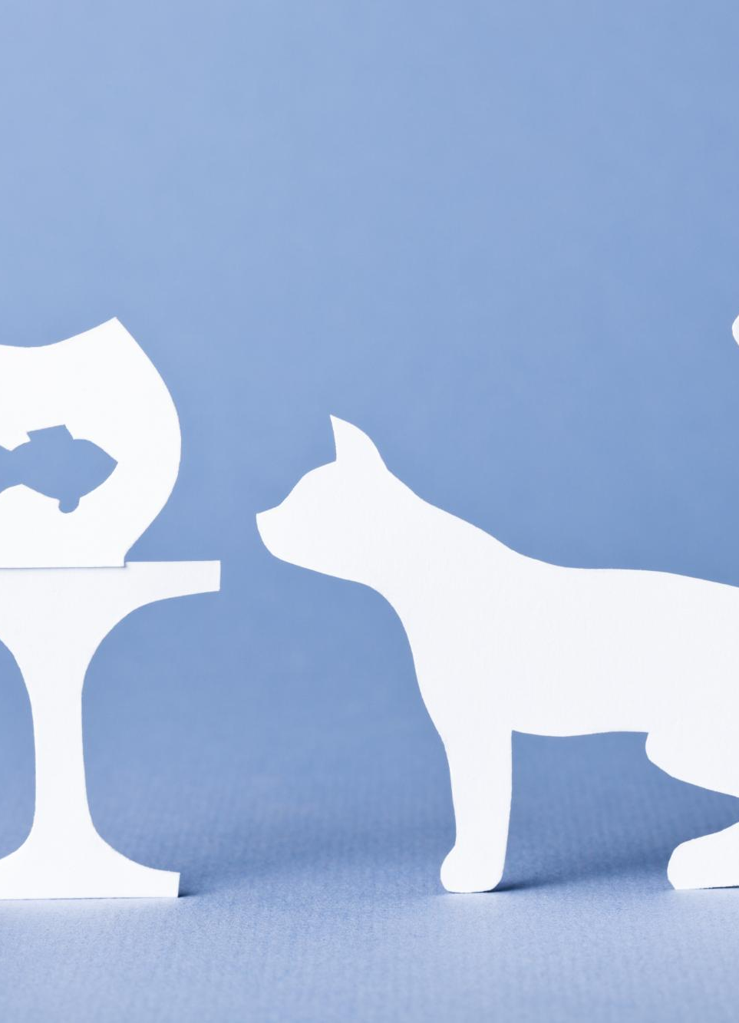
Growing Pet Care Market
Market Growth
The pet care market has experienced significant growth due to rising pet ownership and spending on comfort-enhancing products.
Consumer Investment
Pet owners increasingly invest in products that improve their pets' quality of life, showing a willingness to spend more.
Opportunity for Products
The growing market presents strong opportunities for innovative products like luxury cat beds and accessories.
Notes:
The pet care market has seen significant growth, with an increasing number of pet owners willing to invest in products that enhance their pets' comfort and quality of life, presenting a strong opportunity for this cat bed.

Slide 7
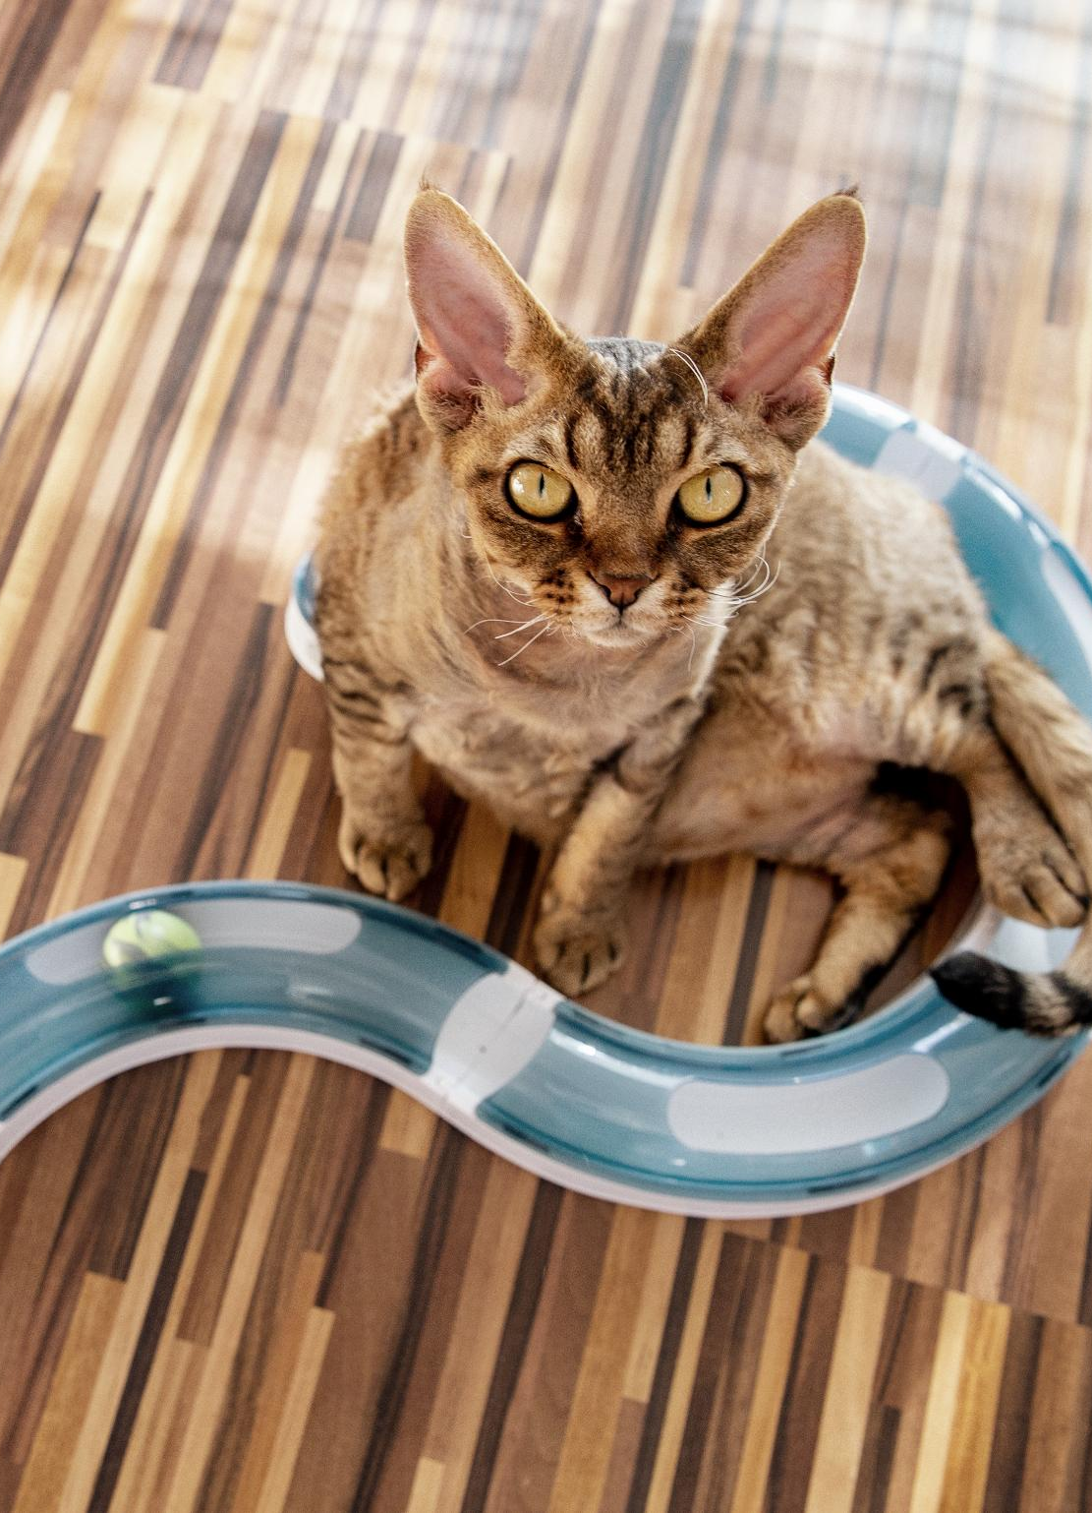
Target Demographics
Cat Owner Characteristics
Our target audience consists of cat owners who value comfort and style for their pets, reflecting their priorities.
Willingness to Invest
This demographic tends to invest more in innovative and functional products that enhance their pets' well-being.
Focus on Health Benefits
Cat owners are increasingly concerned with the health benefits of the products they choose for their feline companions.
Notes:
Our target audience includes cat owners who prioritize comfort, style, and health benefits for their pets. This demographic is often willing to spend more on innovative and functional pet products.

Slide 8
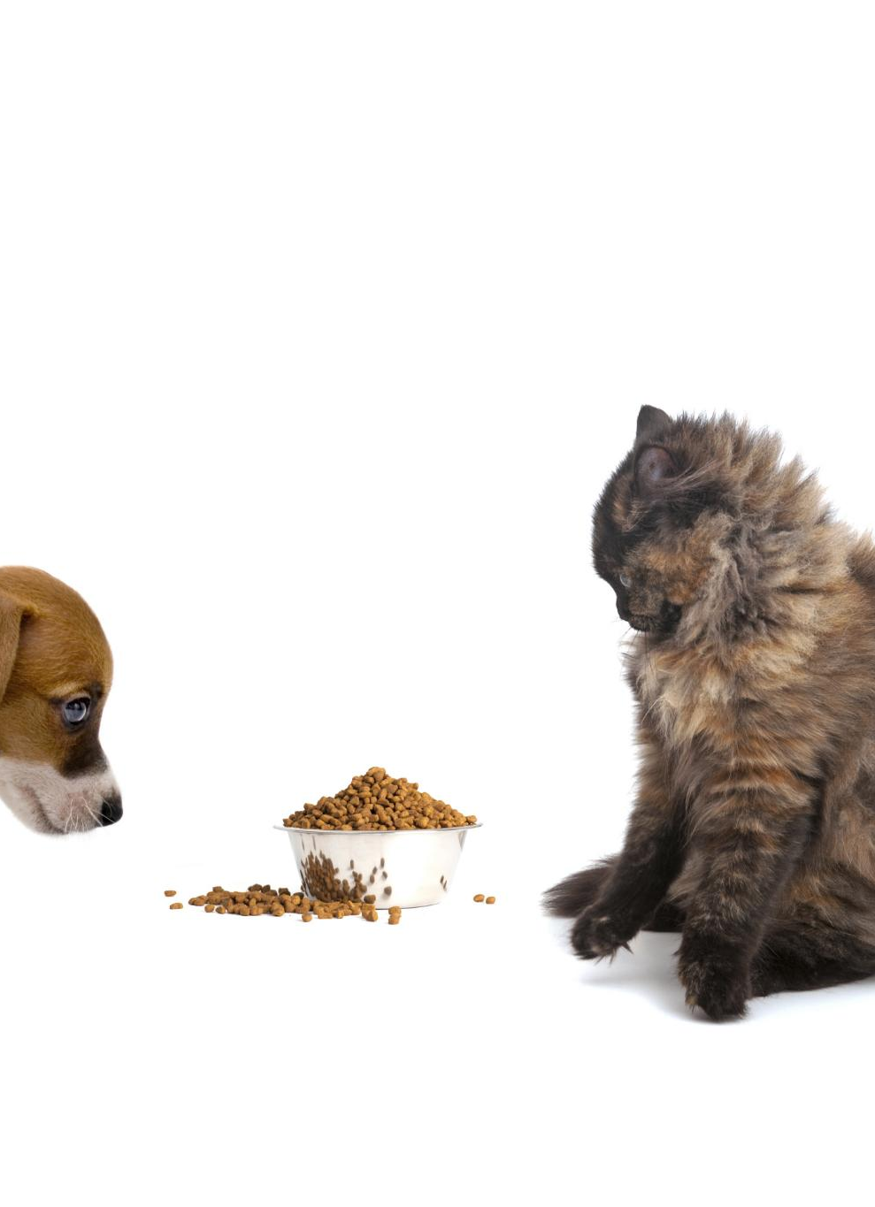
Competitive Analysis
Market Gaps Identification
Conducting a competitive analysis reveals gaps in the market where our product can excel, especially with unique features.
Competitor Understanding
Understanding our competitors helps us position our cat bed effectively in the market to attract potential customers.
Integrated Heating Feature
Our product's integrated heating feature addresses a specific need in the market, offering added comfort for pets.
Notes:
Conducting a competitive analysis reveals gaps in the market where our product can excel, particularly in the integrated heating feature. Understanding competitors helps position our cat bed effectively.

